Slide 1


Hybrid XGBoost + LSTM for
Early Parkinson’s Disease Identification
Using Voice Data
Project Guide: Chandrakanta Mahanty
Presenter Name:
Komal Rani Kar (VU21CSEN0100389)
Rishitha Reddi (VU21CSEN0101651)
Ulsi Divya Sri Varsha (VU21CSEN0100492)
Cheerpurupalli Manjusha (VU21CSEN0101458)
CSE, GST, Visakhapatnam

Slide 2


Contents
S. NO. | TOPICS
1. | Abstract
2. | Introduction
3. | Literature Review
4. | Problem Identification & Key Objectives
5. | Existing System
6. | Proposed System
7. | System Design & Methodology
8. | Web Page Screenshots
9. | Tools & Technologies Used
10. | Results
11. | Conclusion
12. | References
CSE, GST, Visakhapatnam

Slide 3
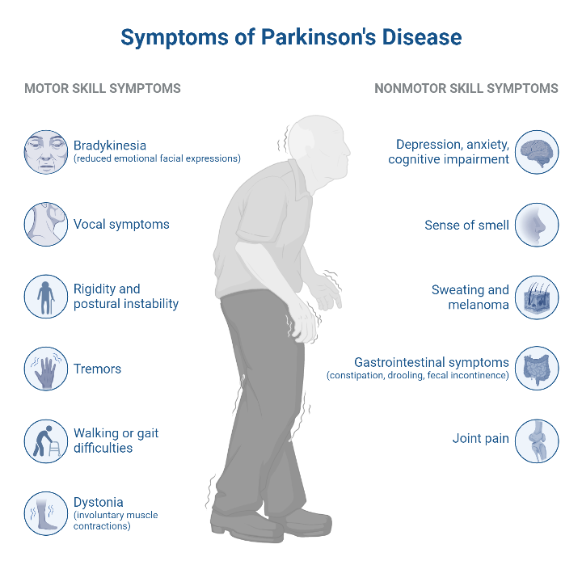

Abstract
This project introduces a hybrid machine learning model that uses LSTM and XGBoost to identify Parkinson's Disease at an early stage using vocal biomarkers. LSTM extracts time features from voice samples, while XGBoost determines the probability of having the disease. The web app facilitates simple vocal data input for real-time predictions as a scalable, non-invasive screening device for clinical and telemedicine applications. The hybrid approach outperforms individual models in accuracy, precision, recall, and F1-score, promoting AI-driven healthcare solutions for early Parkinson’s detection.
CSE, GST, Visakhapatnam

Slide 4
Introduction
Hybrid AI Model (LSTM + XGBoost) for Early PD Diagnosis
Non-invasive, cost-efficient alternative to conventional methods.
Extracts vocal features (MFCCs, jitter, shimmer) for classification.
LSTM for feature extraction, XGBoost for final prediction.
Web interface for real-time vocal data analysis.
Enhances accessibility and clinical decision-making.
CSE, GST, Visakhapatnam

Slide 5
Literature Review
Article Name | Authors | Objectives | Methodology | Results | Limitations
Prediction of Parkinson's Disease using Machine Learning (2023)s | Naresh Alapati, P. Tanuja, N. Anusha, P. Joharika, N. Jenny Jerusha​ | To evaluate different ML algorithms for predicting Parkinson’s Disease (PD) using speech features. | Compared KNN, SVM, RF, and Logistic Regression (LR); RF was used in the proposed system for better accuracy. | RF model showed improved accuracy over KNN for early-stage prediction. | Limited dataset, focus only on early detection, and no deep learning approach used.
Enhancing Parkinson’s Disease Identification using Ensemble Classifier and Data Augmentation (2023) | Mohammed Muzaffar Hussain, D. Weslin, S. Kumari, S. Umamaheswari, K. Kamalakannan​ | To improve PD detection using an ensemble approach with multiple ML models. | Used Random Forest, SVM, and KNN in an ensemble classifier with data augmentation techniques. | Achieved high accuracy in distinguishing PD patients from healthy individuals. | Limited availability of voice data for all patients affected the generalizability.
Parkinson's Disease Detection by Machine Learning (2023) | Dr. M. Nalini, N. Vijayaraj, A. Mary Joy Kinol, Bommi R. M​ | To develop an ML-based system to analyze speech samples for PD detection. | Used SVM with speech features like pitch, jitter, and shimmer for classification. | The proposed method performed well on the speech dataset. | Focuses only on speech analysis, no multimodal approach.
CSE, GST, Visakhapatnam

Slide 6
Literature Review
Article Name | Authors | Objectives | Methodology | Results | Limitations
Detecting Parkinson’s Disease using Machine Learning (2023) | Nancy Deborah R., Vinora A., Alwyn Rajiv S., Ajitha E., Sivakarthi G.​ | To compare different supervised learning methods for PD classification. | Used KNN, SVM, and Logistic Regression on speech datasets. | SVM achieved the highest accuracy among the tested models. | No hybrid or deep learning models considered.
Detection of Parkinson’s Disease using Multiclass Machine Learning Approach (2024) | Saravanan Srinivasan, Parthasarathy Ramadass, Sandeep Kumar Mathivanan, Karthikeyan Panneer Selvam, Basu Dev Shivahare, Mohd Asif Shah​ | To use ML and DL techniques for classifying PD using voice features. | Applied KNN, Feed-Forward Neural Network (FNN), and Kernel SVM with hyperparameter tuning. | FNN achieved 99.11% accuracy, KSVM achieved 95.89% accuracy. | Requires larger datasets for validation, class imbalance addressed via SMOTE.
CSE, GST, Visakhapatnam

Slide 7
Problem Identification
Late Diagnosis: PD is usually diagnosed after extensive neurodegeneration, restricting the effectiveness of treatment.
Subjective & Expensive Diagnosis: The conventional approaches are based on neurologists and costly imaging methods such as MRI & DaTscan.
Underutilization of Voice Biomarkers: 90% of patients with PD have voice impairments, and voice-based detection is seldom utilized.
Limitations of ML Models: Current models target either feature selection or time-series analysis but without a holistic approach.
Lack of Early Screening Programs: There are few large-scale screening programs for Parkinson's, resulting in delayed diagnosis, particularly in disadvantaged areas.
CSE, GST, Visakhapatnam

Slide 8
Key Objectives
✅ Build a Hybrid ML Model – Integrate LSTM for voice feature extraction and XGBoost for classification.
✅ Improve Accuracy with Feature Selection – Pinpoint important vocal parameters such as jitter, shimmer, and fundamental frequency.
✅ Refine Model Performance – Leverage standardization, SMOTE for class balancing, and hyperparameter tuning.
✅ Develop a User-Friendly Web App – Support voice input analysis with straightforward diagnostic results.
✅ Make it Scalable & Accessible Remotely – Scale the model for telemedicine use and early detection.
CSE, GST, Visakhapatnam

Slide 9
Existing System
Current methods for diagnosing Parkinson's Disease (PD) rely on clinical examinations and machine learning models, but they have significant drawbacks:
Clinical Diagnosis – Based on neurological tests and patient history, leading to late detection.
Neuroimaging Techniques – MRI and DaTscan provide detailed brain imaging but are expensive and not easily accessible.
Machine Learning Approaches –
Use independent models like SVM, RF, and KNN, which do not consider time-dependent changes in voice.
Feature-based models focus on extracted vocal features but ignore sequential patterns in speech.
🚨 Drawbacks:
Late Diagnosis – PD is detected only after visible symptoms appear.
High Cost & Invasiveness – MRI and DaTscan are costly and not widely available.
Lack of Sequential Analysis – Most ML models analyze voice features statically.
No Real-Time Accessibility – Limited implementation in easy-to-use interfaces.
CSE, GST, Visakhapatnam

Slide 10
Proposed System
Our system presents a hybrid AI model combining LSTM (sequential voice feature extraction) and XGBoost (classification) for early, accurate, non-invasive PD detection.
✅ Hybrid Machine Learning Model
LSTM – Records time-dependent voice pattern variations (e.g., jitter, shimmer).
XGBoost – Dealt with structured data and tuned classification accuracy.
Feature Engineering & Selection – Minimizes noise and complexity for improved output.
✅ Web-Based Application
User-Friendly Interface – Accepts voice input for real-time prediction.
Secure Login & Data Storage – Guarantees patient data confidentiality.
Scalability for Telemedicine – Facilitates online consultations for early intervention.
CSE, GST, Visakhapatnam

Slide 11
Comparison
Existing System Drawbacks | Proposed System Enhancements
Late Diagnosis | Early Detection via subtle voice changes
Expensive MRI & DaTscan | Non-Invasive Voice Biomarkers
Standalone ML Models | LSTM + XGBoost Hybrid Approach
No Sequential Analysis | Captures Time-Dependent Features
Limited Web Accessibility | User-Friendly Web App for Real-Time Predictions
Data Imbalance Issues | SMOTE for Fair Data Representation
Lower Precision in Classification | Higher Accuracy & F1-Score with Feature Selection
CSE, GST, Visakhapatnam

Slide 12
Functional Requirements
User Authentication
Users can register and log in securely.
Passwords are encrypted for security.
Voice Data Input
Users can input voice-based parameters (e.g., jitter, shimmer, pitch, MFCCs).
System validates and preprocesses the input data.
Real-time Prediction
System gives an immediate result (High/Low likelihood of PD).
Users get a graphical representation of the model’s decision.
Database Management
Stores user information and previous test results.
Logs predictions for analysis and future improvements.
Web-Based Interface
Users can access the system through a web browser.
UI provides simple input and output visualization.
CSE, GST, Visakhapatnam

Slide 13
Non-Functional Requirements
Security
Encryption of user credentials and stored data.
Secure access control to avoid unauthorized access.
Usability
Easy, intuitive interface for non-technical users.
Responsive design for accessibility on different devices.
Scalability
Cloud deployment support for processing multiple requests.
Can be integrated with telemedicine platforms.
Reliability & Availability
Supports high uptime and low downtime.
Makes accurate predictions with low processing delays.
Performance
Optimized model for fast real-time predictions.
Efficient processing of large datasets.
CSE, GST, Visakhapatnam

Slide 14
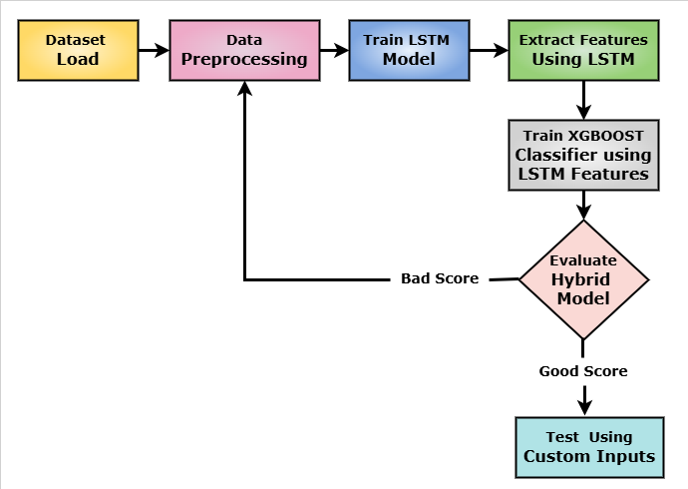
Methodology
1. Data Collection & Preprocessing
Works with voice datasets having features such as pitch, jitter, shimmer, NHR.
Normalization and error removal for consistency.
2. Feature Selection
XGBoost feature importancemethod removes redundant features.
3. Model Training
Hybrid LSTM + XGBoost model trained on PD and non-PD voice samples.
Saves trained model as model.pkl and scaler.pkl.
4. Model Evaluation
Performance measures: Accuracy, Precision, Recall, F1-score, ROC-AUC.
Hybrid model outperforms individual ML models.
5. Web Integration & Deployment
Flask-based web application for real-time prediction.
Secure login and data management.
Fig. 1. Model Design
CSE, GST, Visakhapatnam

Slide 15
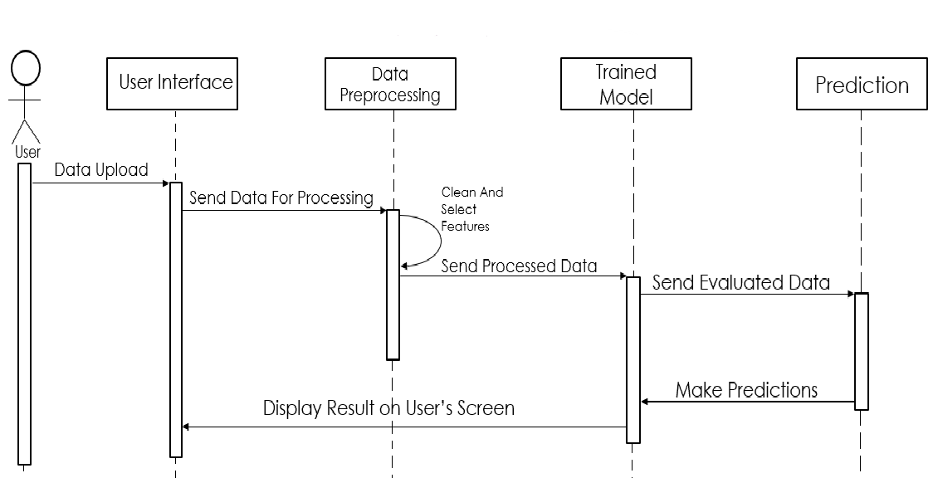
System Design
Fig. 2. Sequence diagram
CSE, GST, Visakhapatnam

Slide 16
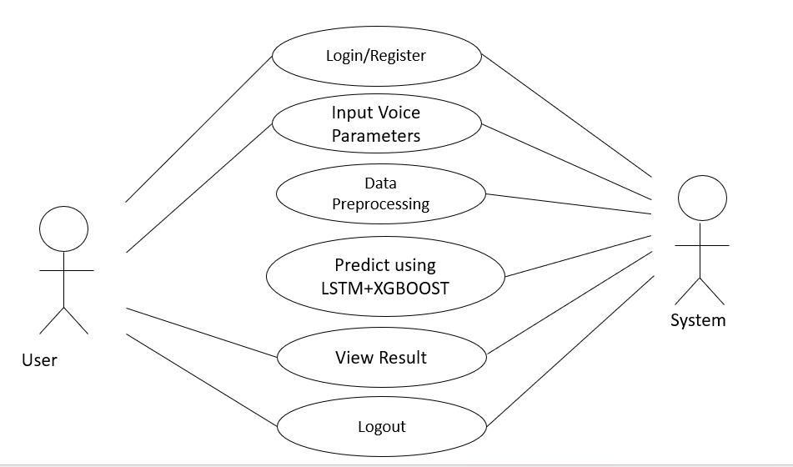
System Design
Fig. 3.: Use-case Diagram
CSE, GST, Visakhapatnam

Slide 17
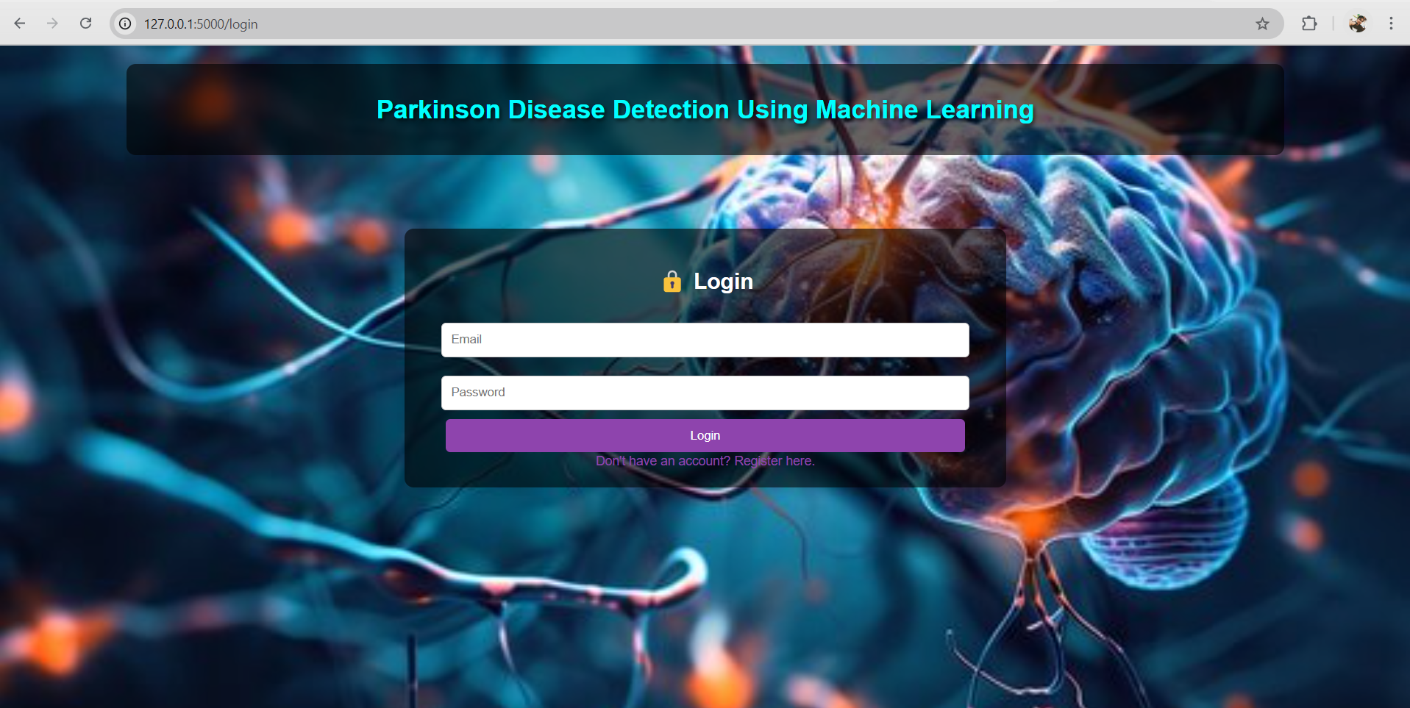

WEB PAGE SCREENSHOTS
CSE, GST, Visakhapatnam

Slide 18
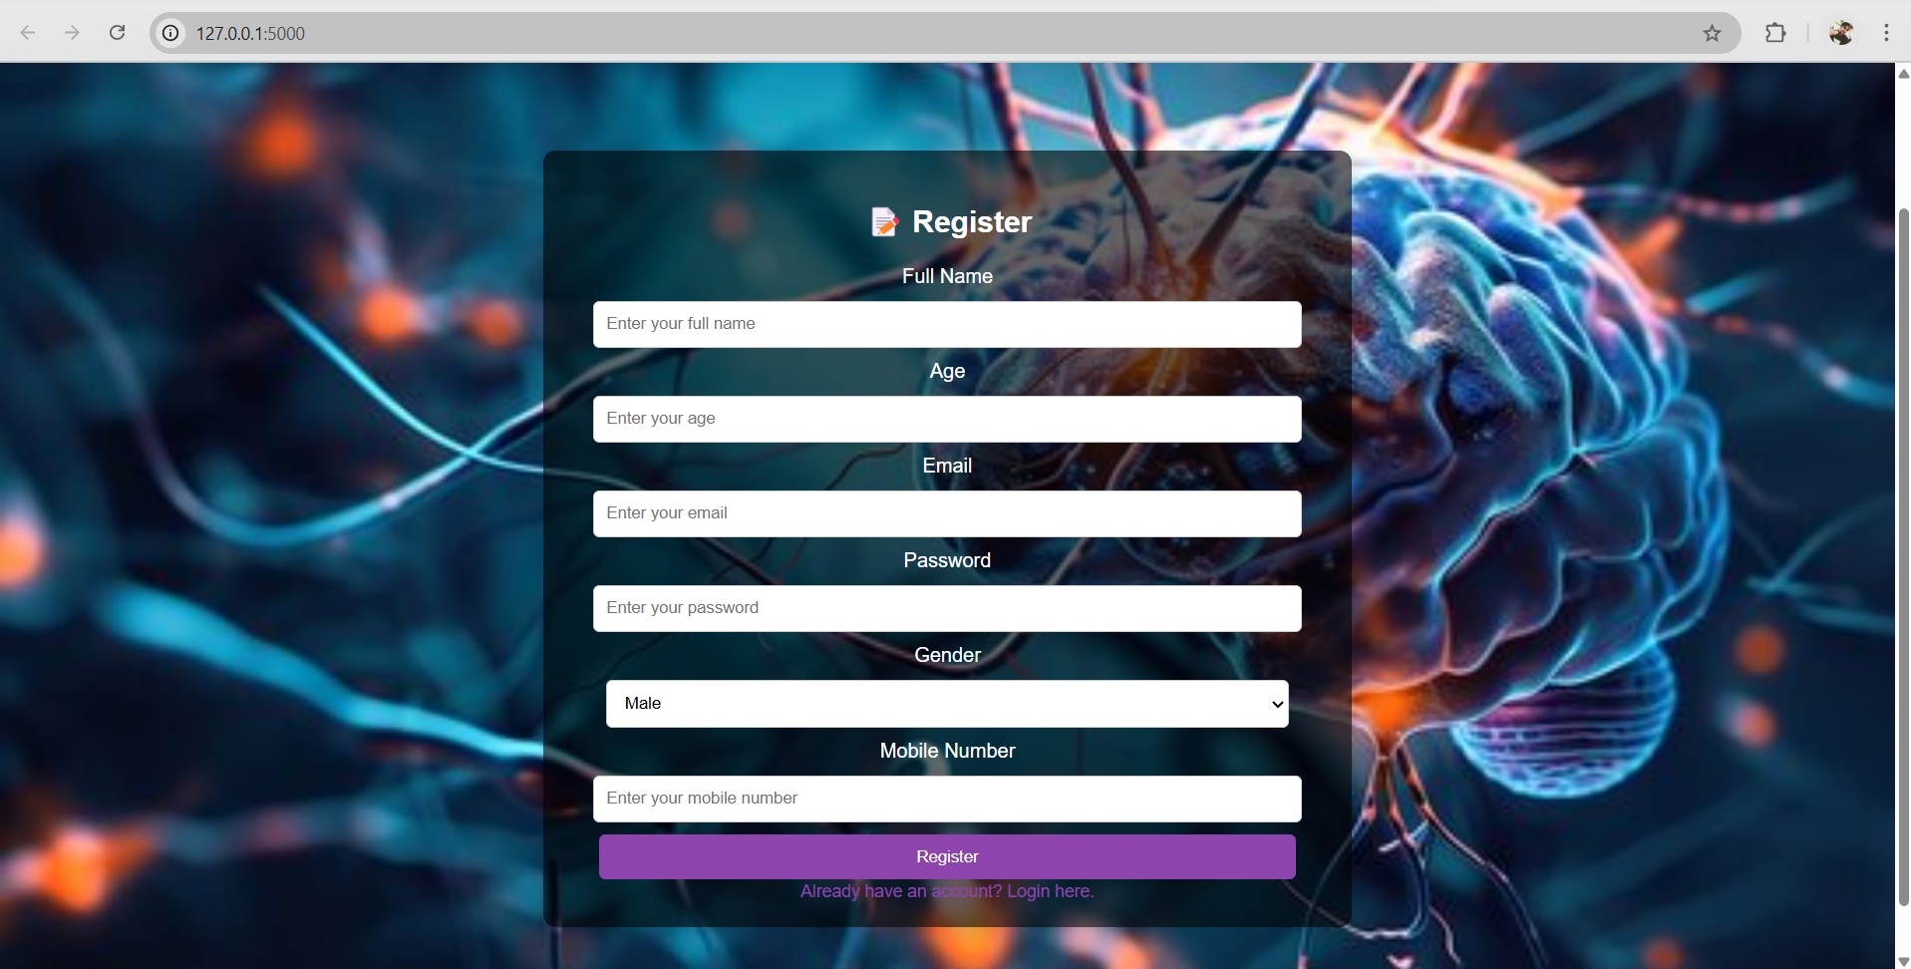
WEB PAGE SCREENSHOTS
CSE, GST, Visakhapatnam

Slide 19
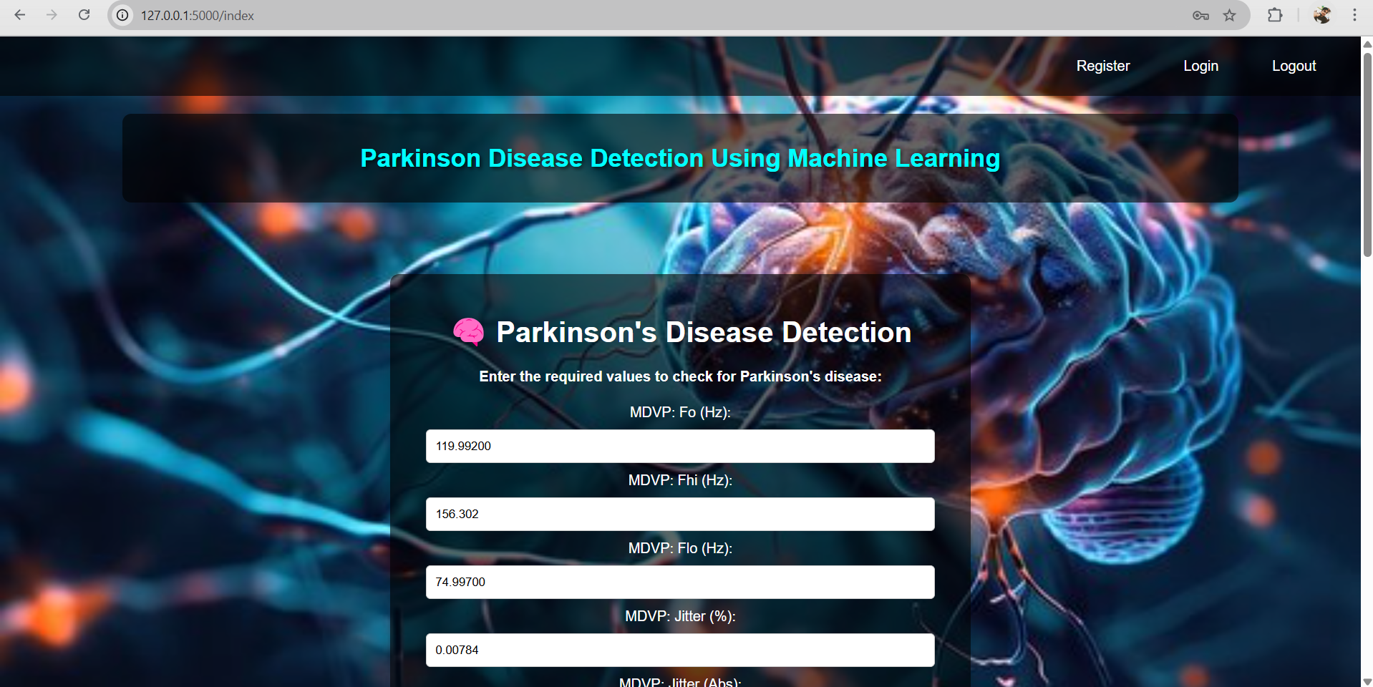
WEB PAGE SCREENSHOTS
CSE, GST, Visakhapatnam

Slide 20
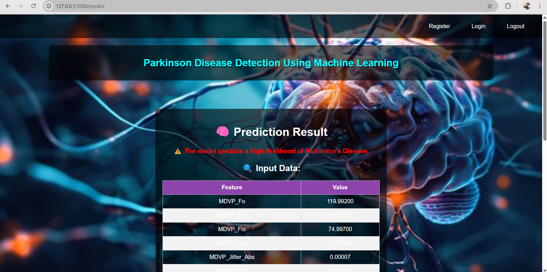
WEB PAGE SCREENSHOTS
CSE, GST, Visakhapatnam

Slide 21
Tools & Technologies Used
Development Environments: Jupyter Notebook, VS Code.
Programming Languages: Python (ML & Backend), HTML, CSS, JavaScript (Frontend).
ML/DL Frameworks: TensorFlow, Keras (LSTM), XGBoost, Scikit-Learn.
Web Frameworks: Flask
Database & Storage: SQLite, Pickle, Joblib.
Data Processing & Visualization: Pandas, NumPy, Matplotlib, Seaborn.
Model Optimization: Hyperparameter tuning (GridSearchCV, SMOTE for class balancing).
Deployment: Flask Web Server, Cloud hosting (AWS, Heroku).
CSE, GST, Visakhapatnam

Slide 22
Results
The performance of the three models—Hybrid (LSTM + XGBoost), Standalone XGBoost, and Standalone LSTM—was analyzed based on key metrics: accuracy, precision, recall, F1-score, and AUC.
Metric | Hybrid Model (LSTM + XGBoost) | Standalone XGBoost | Standalone LSTM
Accuracy | 97% | 92% | 85%
Precision | 97% | 93% | 96%
Recall | 100% | 97% | 83%
F1-Score | 98% | 95% | 89%
ROC AUC | 99% | 96% | 97%
CSE, GST, Visakhapatnam

Slide 23
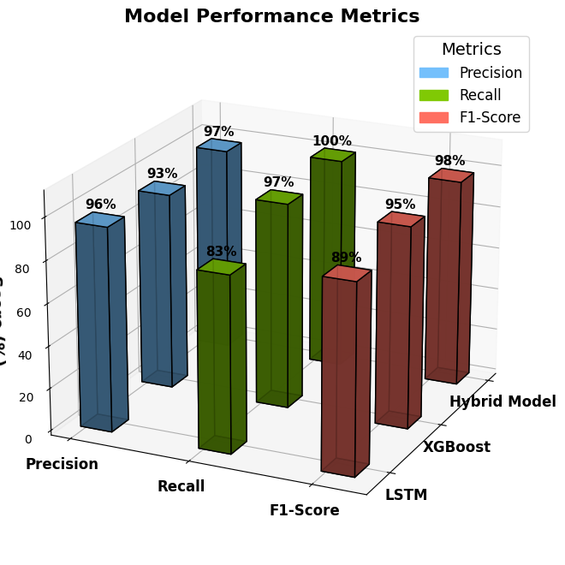
Results
Fig. 4. Performance metrices of the models
CSE, GST, Visakhapatnam

Slide 24
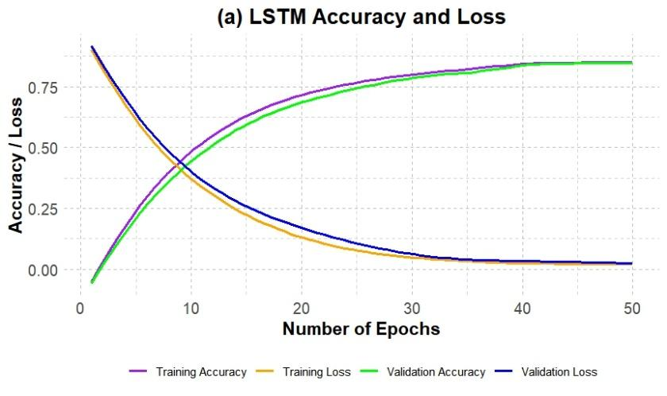
Results
CSE, GST, Visakhapatnam

Slide 25
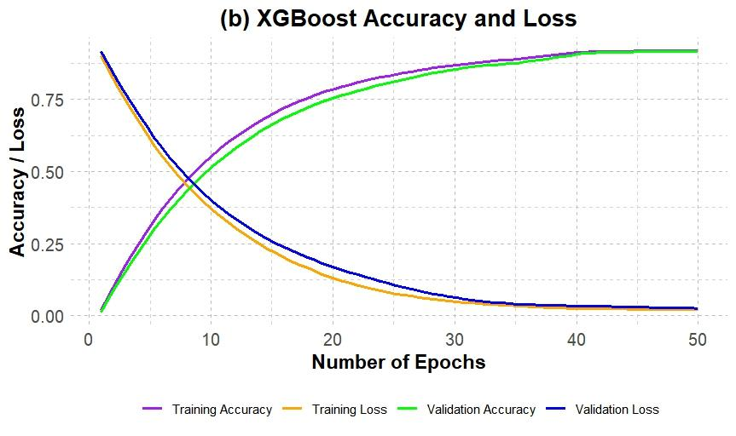
Results
CSE, GST, Visakhapatnam

Slide 26
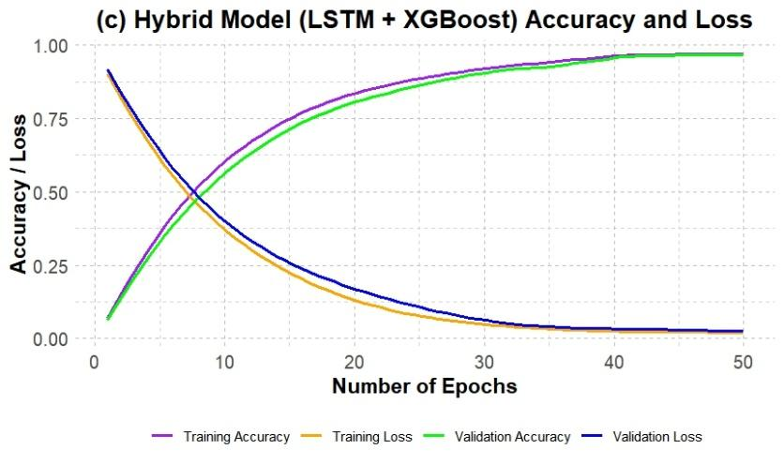
Results
CSE, GST, Visakhapatnam

Slide 27
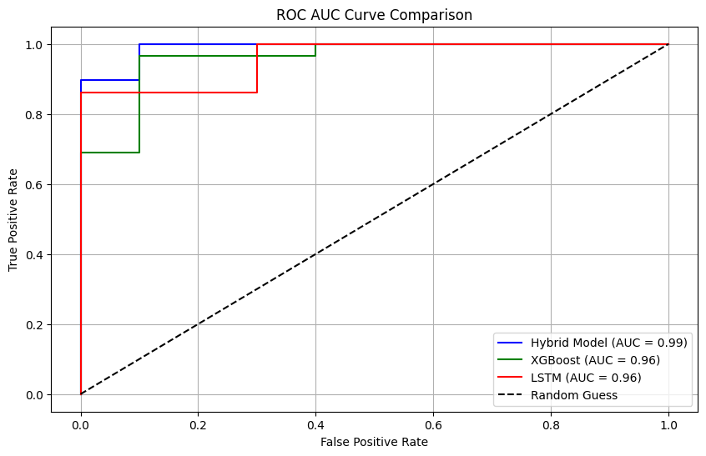
Results
CSE, GST, Visakhapatnam

Slide 28
Conclusion
The proposed hybrid model efficiently integrates XGBoost and LSSTM to enhance the accuracy and efficiency of Parkinson's Disease diagnosis. With performance metrics showing high accuracy (0.97) precision (0.97), recall (1.00), F1-score (0.98) and ROC-AUC (0.99) the model offers a significant improvement over traditional diagnostic approaches. PD detection is a rapidly changing system which can transform early PD detection and enhance patient care
CSE, GST, Visakhapatnam

Slide 29
References
Vinora, A., E. Ajitha, and G. Sivakarthi. "Detecting parkinson's disease using machine learning." 2023 International Conference on Artificial Intelligence and Knowledge Discovery in Concurrent Engineering (ICECONF). IEEE, 2023.
Fang, Zhaozhao. "Improved KNN algorithm with information entropy for the diagnosis of Parkinson's disease." 2022 International Conference on Machine Learning and Knowledge Engineering (MLKE). IEEE, 2022.
Alshammri, Raya, et al. "Machine learning approaches to identify Parkinson's disease using voice signal features." Frontiers in artificial intelligence 6 (2023): 1084001.
Govindu, Aditi, and Sushila Palwe. "Early detection of Parkinson's disease using machine learning." Procedia Computer Science 218 (2023): 249-261.
Nalini, M., Mary Joy Kinol, and N. Vijayaraj. "Parkinson's Disease Detection by Machine Learning." 2023 Intelligent Computing and Control for Engineering and Business Systems (ICCEBS). IEEE, 2023.
Hussain, Sayyed Shahid, et al. "Classification of Parkinson’s disease in patch-based MRI of substantia nigra." Diagnostics 13.17 (2023): 2827.
Alapati, Naresh, et al. "Prediction of Parkinson's Disease using Machine Learning." 2023 Second International Conference on Electronics and Renewable Systems (ICEARS). IEEE, 2023.
Srinivasan, Saravanan, et al. "Detection of Parkinson disease using multiclass machine learning approach." Scientific Reports 14.1 (2024): 13813.
CSE, GST, Visakhapatnam

Slide 30
Thank You
CSE, GST, Visakhapatnam

